Slide 1

Towards Performance Guarantees in Emerging Wireless Network Applications
Arani Bhattacharya
Thesis Defense
Stony Brook University

Slide 2






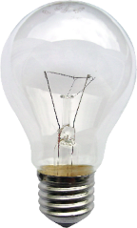
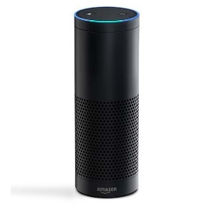
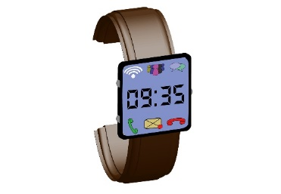
Number of wireless devices is increasing
Wireless Devices
Access Point
Backhaul
Wired Network
Internet
1) Wireless channel or spectrum getting more busy!
All wireless devices utilize spectrum
Notes:
Spectrum scarcity. Cost of spectrum increased from 17 cents/MHz from 2009 to 51 MHz to 2016.

Slide 3





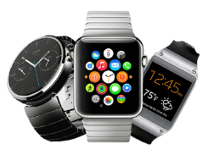
But Spectrum is a Limited Resource
Increase of 3x in 7 years
Data Courtesy: Effective Spectrum Pricing: Supporting better quality and more affordable mobile services, Full Report, February 2017, Nera Economic Consulting
Spectrum is getting more expensive;
Regulators need to protect it from illegal use
Notes:
Spectrum scarcity. Cost of spectrum increased from 17 cents/MHz from 2009 to 51 MHz to 2016.

Slide 4
Need to run applications on devices with weak processors
Wireless Devices
Access Point
Backhaul
Wired Network
Internet
2) Devices are getting smaller and less autonomous
How can such devices run complex applications?
Notes:
Spectrum scarcity. Cost of spectrum increased from 17 cents/MHz from 2009 to 51 MHz to 2016.

Slide 5

Computation offloading can allow running of complex applications
Wireless Devices
Access Point
Backhaul
Wired Network
Internet
Cloud Server
Small devices offload to cloud
Small devices can offload their compute-intensive tasks to devices with larger processors
Notes:
Spectrum scarcity. Cost of spectrum increased from 17 cents/MHz from 2009 to 51 MHz to 2016.

Slide 6



Our Focus is on Two Wireless Applications
1) Regulators need to protect spectrum from illegal use
Intruder
(Unauthorized transmitter)
$
Spectrum Monitoring
$
$
$
Computation Offloading
Cloud Server
2) Small devices offload to cloud
Notes:
Spectrum scarcity. Cost of spectrum increased from 17 cents/MHz from 2009 to 51 MHz to 2016.

Slide 7
Content Outline
Introduction and Motivation
Spectrum Monitoring
Computation Offloading to Reduce Execution Time
Conclusion
Notes:
No need to discuss the current approach. Also change this spectrum or signal map.

Slide 8
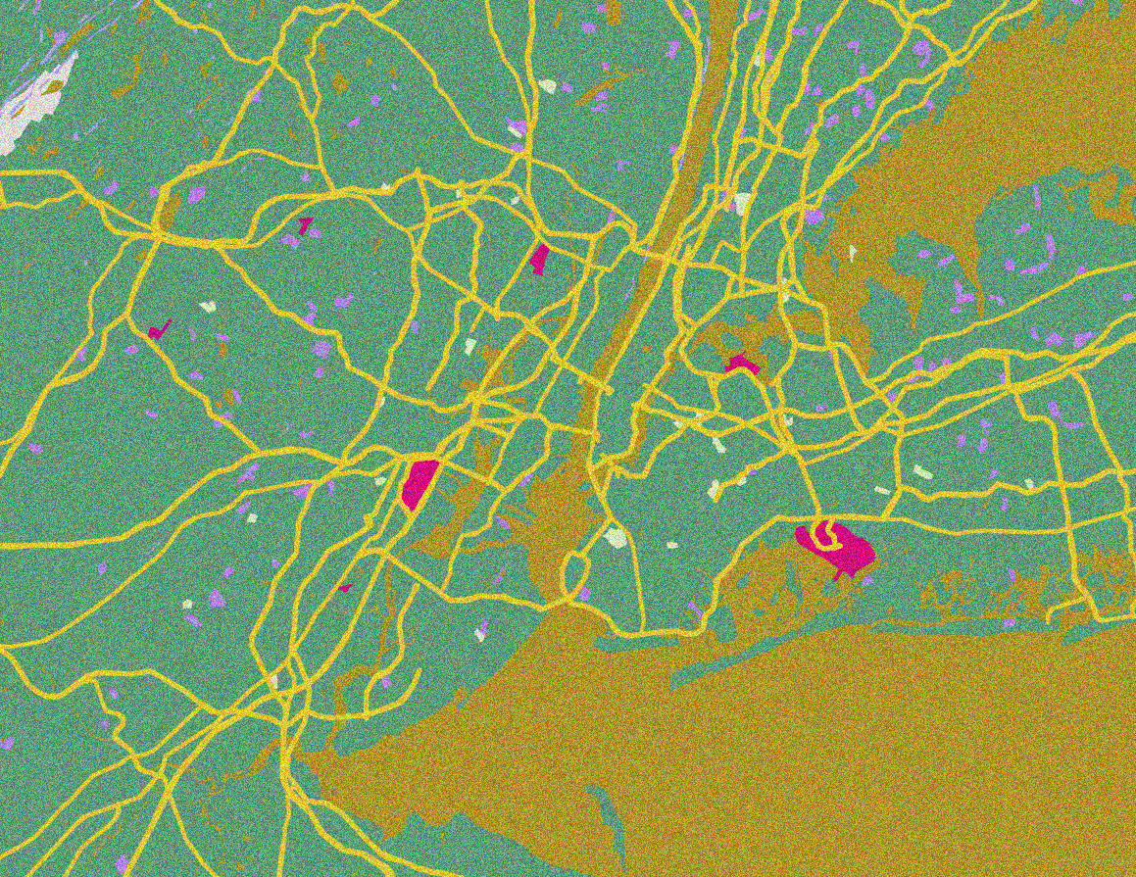
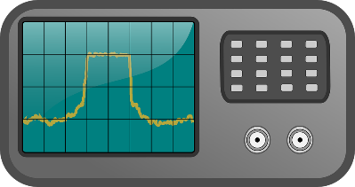
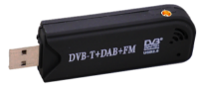

How can Regulators Protect Spectrum?
Intruder
(Unauthorized transmitter)
Illegal transmitters must be detected:
1) With high accuracy
2) At low cost
Possible either using one spectrum analyzer or multiple cheap software-defined radios
Notes:
No need to discuss the current approach. Also change this spectrum or signal map.

Slide 9
Two Ways of Monitoring Spectrum
Intruder
(Unauthorized transmitter)
$1000
Single spectrum analyzer
Large number of inexpensive sensors
$50
We focus on deploying large number of inexpensive sensors
Notes:
No need to discuss the current approach. Also change this spectrum or signal map.

Slide 10
Running Many Sensors Incurs Recurring Cost
Intruder
(Unauthorized transmitter)
Energy consumption and sending data both have monetary cost
Individual sensor decisions need to be processed to get a global decision
Deployed sensors
We reduce recurrent cost while ensuring accurate spectrum monitoring
Notes:
No need to discuss the current approach. Also change this spectrum or signal map.

Slide 11
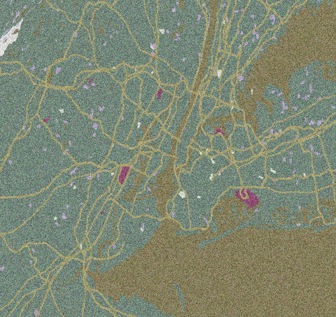
Our Contributions
INFOCOM’20
(Under Submission)
To be submitted
Offline Sensor
Selection
Online Sensor
Selection
Low-cost Spectrum Monitoring
Low-cost Spectrum Monitoring
DySPAN’18
INFOCOM’18,
IEEE Tran. Cog. Comm.’ 19
FPGA-based
Sensors
Fusion of Noisy Sensors
Notes:
Spectrum scarcity. Cost of spectrum increased from 17 cents/MHz from 2009 to 51 MHz to 2016.

Slide 12
“Selection of Sensors for Efficient
Transmitter Localization”
INFOCOM’20
(Under Submission)
Offline Sensor
Selection
Online Sensor
Selection
Low-cost Spectrum Monitoring
Low-cost Spectrum Monitoring
FPGA-based
Sensors
Fusion of Noisy Sensors
Notes:
Spectrum scarcity. Cost of spectrum increased from 17 cents/MHz from 2009 to 51 MHz to 2016.

Slide 13
How can we Reduce Cost?
Multiple sensors close to each other may send redundant data
Can we reduce cost without hurting accuracy?
Select sensors
Cost reduction possible by selecting the most relevant sensors
Notes:
No need to discuss the current approach. Also change this spectrum or signal map.

Slide 14
Problem Setting
Intruder
(Unauthorized transmitter)
Each sensor reports how much power it senses in a particular band
?
Identifies location or presence of intruder
Fusion
Algorithm
Select sensors
Notes:
No need to discuss the current approach. Also change this spectrum or signal map.

Slide 15
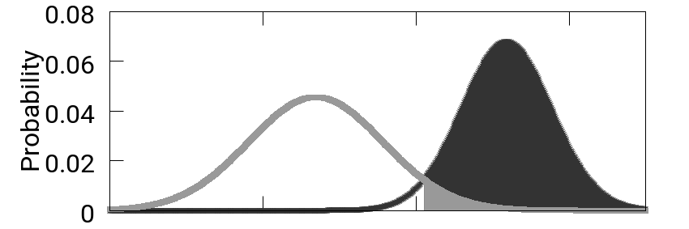
Signals are Corrupted by Noise
Noise
Distribution
Signal
Distribution
?
Select sensors
Stochastic decision problem; multiple sensors can be used to improve the decision
Notes:
No need to discuss the current approach. Also change this spectrum or signal map.

Slide 16
Maximum a Posteriori Estimate
Divide entire area into grid cells
H1
H2
H3
Label each cell as a hypothesis
Compute probability of each hypothesis using Bayes rule
Select sensors
Select maximum
Provides the optimal accuracy;
shown by R. A. Fisher in 1921
Notes:
No need to discuss the current approach. Also change this spectrum or signal map.

Slide 17
Which Subset of Sensors Provide Best Accuracy?
Intruder
(Unauthorized transmitter)
Max Accuracy
subject to:
# Sensors ≤ Budget
?
Select sensors
Need to solve this optimization problem
Notes:
No need to discuss the current approach. Also change this spectrum or signal map.

Slide 18


Solving this optimization is NP-Hard
Intruder
(Unauthorized transmitter)
No guarantee of accuracy
?
OR
Slow execution
Select sensors
Need to select a good subset fast
Notes:
No need to discuss the current approach. Also change this spectrum or signal map.

Slide 19
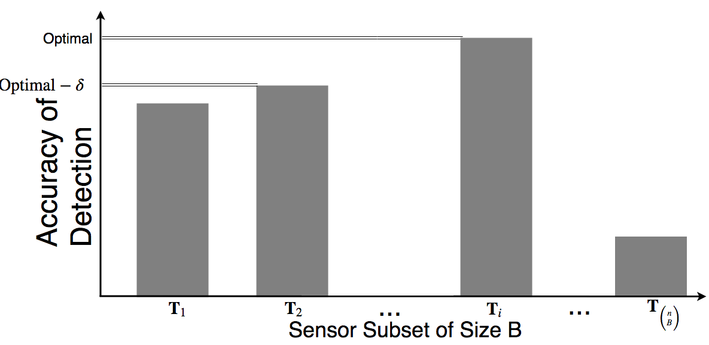
What is the Best or “Optimal” Subset?
n = Total Number of Available Sensors
B = Number of budgeted sensors
Accuracy of Localization
Not possible to get quickly because of NP-Hardness
Notes:
No need to discuss the current approach. Also change this spectrum or signal map.

Slide 20

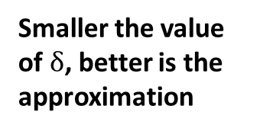
Getting "Near-Optimal" Subset
n = Total Number of Available Sensors
B = Number of budgeted sensors
Smaller the value of $δ$, better is the approximation
$$δ$$
Accuracy of Localization
Getting near-optimal subset quickly is possible under "certain" conditions
Notes:
No need to discuss the current approach. Also change this spectrum or signal map.

Slide 21
Two Key Conditions on Objective Function
“Monotone”:
No sensor has a negative gain
“Submodular”:
Gains follow law of diminishing returns
Accuracy of Localization
Accuracy of Localization
Size of subset
Size of subset
Monotone submodular objectives have approximation results
Notes:
No need to discuss the current approach. Also change this spectrum or signal map.

Slide 22

Approximate Result Using “Greedy” Algorithm
“Monotone”:
No sensor has a negative gain
Start with empty subset
“Submodular”:
Gains follow law of diminishing returns
For all available sensors, compute gain and select the one with highest gain
Accuracy of Localization
Accuracy of Detection
No
Budget reached?
Gives a $δ$ of 1/e
[Nemhauser ‘78]
Size of subset
Size of subset
Yes
Return selected sensors
Notes:
No need to discuss the current approach. Also change this spectrum or signal map.

Slide 23


Does accuracy of classification satisfy these criteria?
“Monotone”:
No sensor has a negative gain
“Submodular”:
Gains follow law of diminishing returns
Accuracy of Localization
Accuracy of Localization
Size of subset
Size of subset
Our objective is NOT submodular;
Greedy algorithm does NOT give approximate result
Notes:
No need to discuss the current approach. Also change this spectrum or signal map.

Slide 24
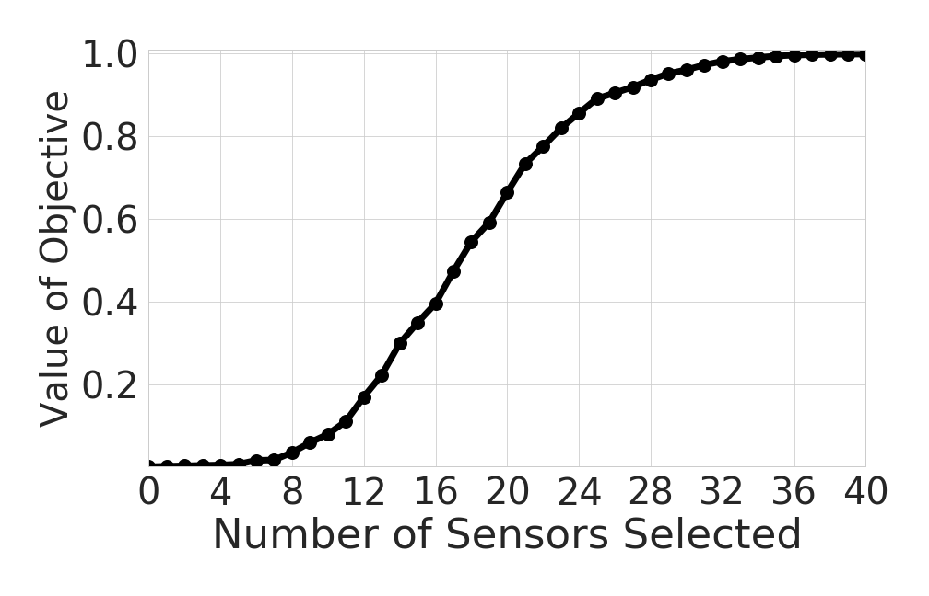
How does Accuracy of Classification
Actually Behave?
Accuracy of Localization
Submodular
Only a part of the objective is submodular. Deviates from submodularity on increasing number of hypotheses
Notes:
No need to discuss the current approach. Also change this spectrum or signal map.

Slide 25
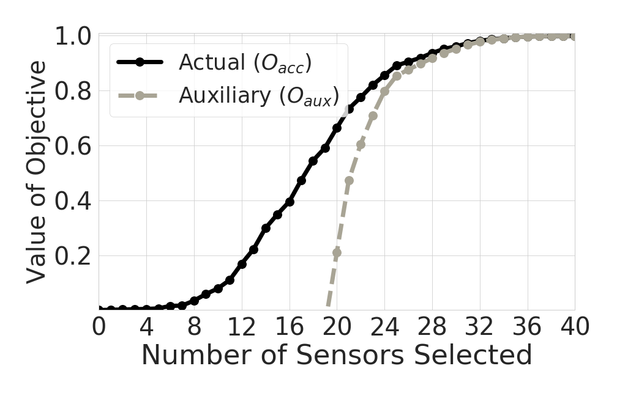
Can we Design an Auxiliary Monotone Submodular Objective?
Accuracy of Localization
(Auxiliary) Greedy algorithm gives near-optimal value of auxiliary objective
Notes:
No need to discuss the current approach. Also change this spectrum or signal map.

Slide 26
Does it also Give Guarantee on Performance of Actual Objective?
Analytically show that this difference is within a bound.
Bound reduces with an increase in budget
Accuracy of Localization
Accuracy of Localization
Applying greedy algorithm on auxiliary objective provides guarantee on accuracy
Notes:
No need to discuss the current approach. Also change this spectrum or signal map.

Slide 27
Performance Evaluation
Simulation for Large-Scale Experiments
Data generated using Longley-Rice propagation model
Area of 16 sq. km divided into 1600 grid cells
Set of 100 sensors deployed randomly
Repeated 100 times to prove statistical significance
Notes:
No need to discuss the current approach. Also change this spectrum or signal map.

Slide 28
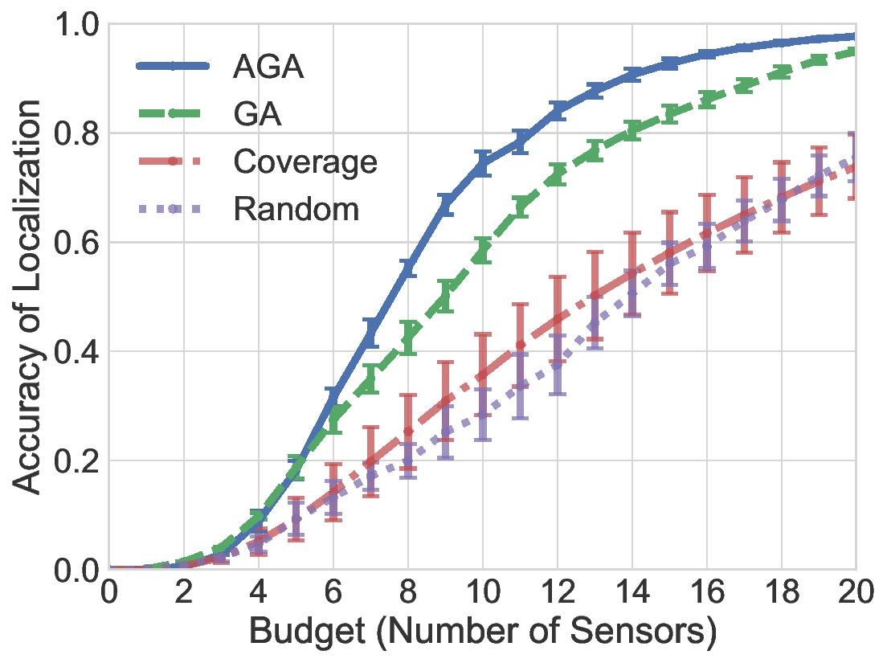
Comparison with State-of-the-Art
Simulation Result
Up to 16% better than basic greedy
Up to 40% better than coverage
Our algorithm provides higher accuracy in practice
Notes:
No need to discuss the current approach. Also change this spectrum or signal map.

Slide 29
Performance Evaluation
Real-data Experiments
Indoor settings:
  Area of 196 sq. m
  44 sensors and transmitters
  Collected in a campus building at University of Utah
Outdoor settings:
  Area of 100 sq. m
  100 transmitters, 18 RTL-SDR based sensors
  Collected in South P Lot
Notes:
No need to discuss the current approach. Also change this spectrum or signal map.

Slide 30
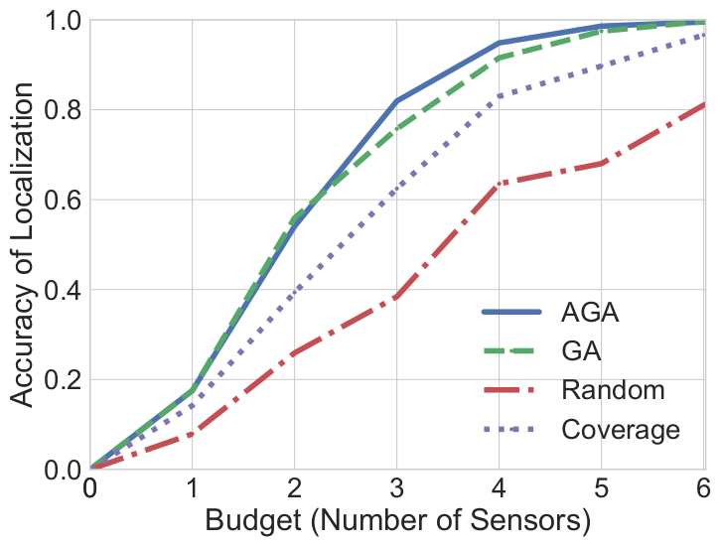
Comparison with State-of-the-Art
Indoor Setting
Up to 5% better than (basic) greedy
Up to 16% better than coverage
Our algorithm provides higher accuracy in practice
Notes:
No need to discuss the current approach. Also change this spectrum or signal map.

Slide 31
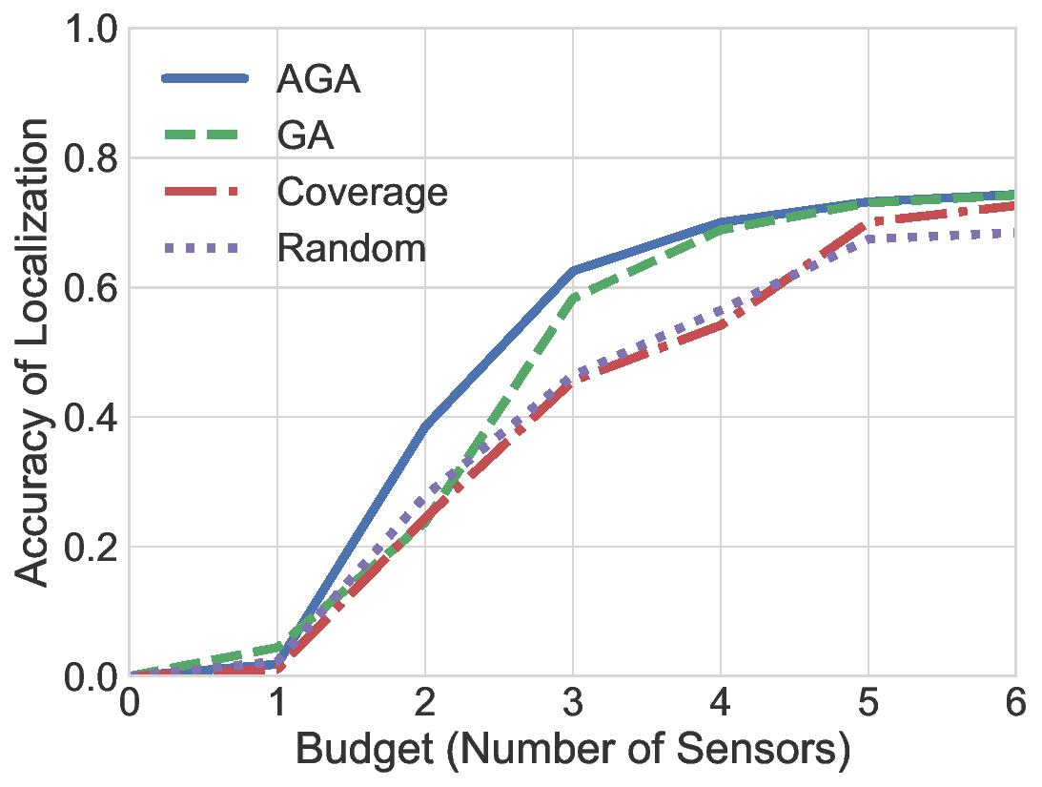
Comparison with State-of-the-Art
Outdoor Setting
Up to 15% better than coverage
Up to 12% better than (basic) greedy
Our algorithm provides higher accuracy in practice
Notes:
No need to discuss the current approach. Also change this spectrum or signal map.

Slide 32


Dealing with Slow Execution
Intruder
(Unauthorized transmitter)
No guarantee of accuracy
?
OR
Slow execution
Select sensors
Is greedy algorithm fast?
Notes:
No need to discuss the current approach. Also change this spectrum or signal map.

Slide 33
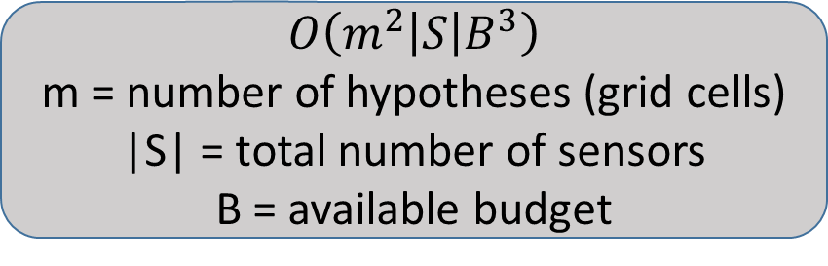
Time Complexity of Our Algorithm
$$O\left(m^{2}\left|S\right|B^{3}\right)$$
m = number of hypotheses (grid cells)
|S| = total number of sensors
B = available budget
Slow execution
??
15 min
Intel Core i9 processor with 20 cores; nVidia 1080 GTX GPU
Execution time
(Not drawn to scale)
40 s
m = 1600
m = 6400
|S| = 100, B = 20
Execution Parameters
Greedy algorithm is still too slow!
Notes:
No need to discuss the current approach. Also change this spectrum or signal map.

Slide 34
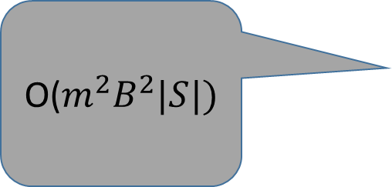
Finding the Bottleneck in Our Algorithm
“Monotone”:
No sensor has a negative gain
Start with empty subset
“Submodular”:
Gains follow law of diminishing returns
O($m^{2}B^{2}|S|)$
For all available sensors, compute gain and select the one with highest gain
Accuracy of Localization
Accuracy of Detection
No
Budget reached?
Size of subset
Size of subset
Yes
Return selected sensors
Notes:
No need to discuss the current approach. Also change this spectrum or signal map.

Slide 35
Two Key Observations
Selecting a sensor affects probabilities ONLY within a limited area
  Only iterate over a limited circular area with constant number of hypotheses
Covariance matrix is diagonal
  Using dynamic programming, compute the gain of one sensor in constant time
Time Complexity Reduces to O(|S|B)
Notes:
No need to discuss the current approach. Also change this spectrum or signal map.

Slide 36
Finding the Bottleneck in Our Algorithm
“Monotone”:
No sensor has a negative gain
Start with empty subset
“Submodular”:
Gains follow law of diminishing returns
O(|S|)
For all available sensors, compute gain and select the one with highest gain
Accuracy of Localization
Accuracy of Detection
No
Budget reached?
Size of subset
Size of subset
Yes
Return selected sensors
Notes:
No need to discuss the current approach. Also change this spectrum or signal map.

Slide 37
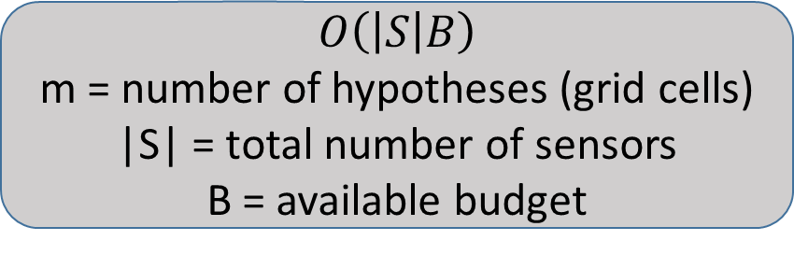
Time Complexity of Our Algorithm
$$O\left(\left|S\right|B\right)$$
m = number of hypotheses (grid cells)
|S| = total number of sensors
B = available budget
Slow execution
15 min
Intel Core i9 processor with 20 cores; nVidia 1080 GTX GPU
Execution time
(Not drawn to scale)
1 min
40 s
10 s
m = 1600
m = 6400,
|S| = 100, B = 20
Execution Parameters
Greedy algorithm is now much faster!
Notes:
No need to discuss the current approach. Also change this spectrum or signal map.

Slide 38
Performance of Our Algorithm
Intruder
(Unauthorized transmitter)
No guarantee of accuracy
?
OR
Slow execution
Select sensors
We guarantee both fast execution and near-optimal accuracy for any given budget
Notes:
No need to discuss the current approach. Also change this spectrum or signal map.

Slide 39
“Online Selection of Sensors for
Transmitter Localization”
To be submitted
Offline Sensor
Selection
Online Sensor
Selection
Low-cost Spectrum Monitoring
Low-cost Spectrum Monitoring
FPGA-based
Sensors
Fusion of Noisy Sensors
Notes:
Spectrum scarcity. Cost of spectrum increased from 17 cents/MHz from 2009 to 51 MHz to 2016.

Slide 40
Online Selection Can Give More Accurate Results
Intruder
(Unauthorized transmitter)
?
Select next sensor after probing a previous sensor
Select sensors
Improves accuracy and reduce cost
Notes:
No need to discuss the current approach. Also change this spectrum or signal map.

Slide 41
Greedy Policy is the Best Strategy
Intruder
(Unauthorized transmitter)
?
“Best” sensor is the one which reduces entropy the most
Select sensors
Selecting the best sensor at each step provides a bound with the optimal strategy
Notes:
No need to discuss the current approach. Also change this spectrum or signal map.

Slide 42
“Quantifying Energy and Latency Improvements of FPGA-Based Sensors for Low-Cost Spectrum Monitoring”
Offline Sensor
Selection
Online Sensor
Selection
Low-cost Spectrum Monitoring
Low-cost Spectrum Monitoring
DySPAN’18
FPGA-based
Sensors
Fusion of Noisy Sensors
Notes:
Spectrum scarcity. Cost of spectrum increased from 17 cents/MHz from 2009 to 51 MHz to 2016.

Slide 43
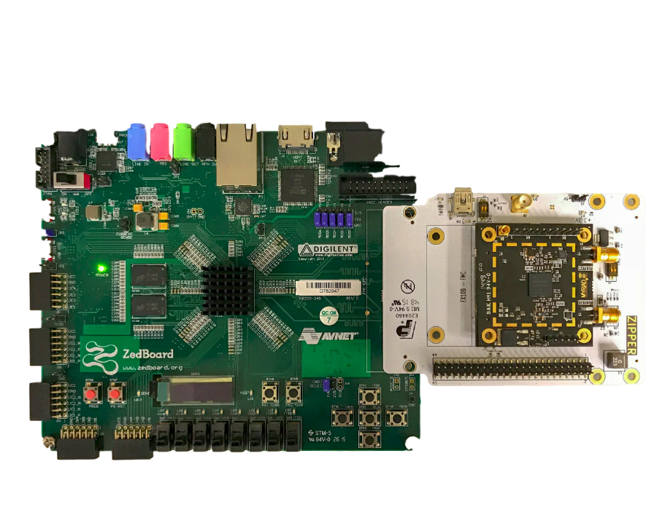
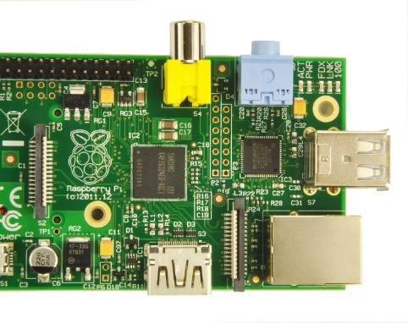
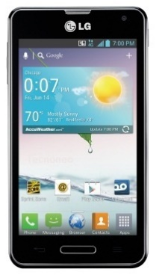
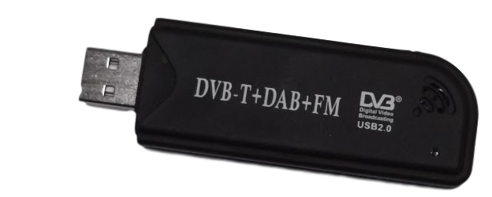
Benchmark Performance of FPGA-based Spectrum Sensors
FPGA-board with SDR
Android smartphone
with RTL-SDR
Raspberry Pi connected to RTL-SDR
Latency: x 69
Energy: x 6
Latency: x 73
Energy: x 8
FPGA-based spectrum sensors can reduce cost
Notes:
No need to discuss the current approach. Also change this spectrum or signal map.

Slide 44
“Spectrum Patrolling with Crowdsourced Spectrum Sensors”
Offline Sensor
Selection
Online Sensor
Selection
Low-cost Spectrum Monitoring
Low-cost Spectrum Monitoring
INFOCOM’18,
IEEE Trans. Cog. Comm’19
FPGA-based
Sensors
Fusion of Noisy Sensors
Notes:
Spectrum scarcity. Cost of spectrum increased from 17 cents/MHz from 2009 to 51 MHz to 2016.

Slide 45
Sensors May also Send their Local Decisions
Present
Local
Decisions
Absent
?
Present
Present
Global Decision
Fusion
Algorithm
Present
Absent
Fusion algorithm needs to get a global decision about the presence of transmitter
Notes:
No need to discuss the current approach. Also change this spectrum or signal map.

Slide 46
We Utilize Local Decisions to get a Global Decision
Present
Sensor Model (PD, PFA)
Local
Decisions
Absent
?
Linear combination
Present
Present
Optimal global decision
Fusion
algorithm
We weigh the output of each sensor to get the optimal global decision
Notes:
No need to discuss the current approach. Also change this spectrum or signal map.

Slide 47
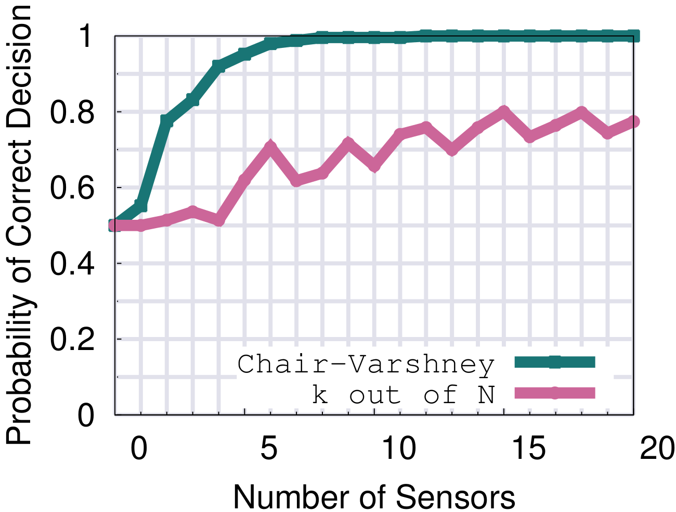
Evaluation of Our Sensor Fusion Algorithm
Up to 38% improvement in accuracy
Our sensor fusion performs better than baseline
Notes:
No need to discuss the current approach. Also change this spectrum or signal map.

Slide 48
Our Contributions on Spectrum Patrolling
INFOCOM’20
(Under Submission)
To be submitted
Offline Sensor
Selection
Online Sensor
Selection
Low-cost Spectrum Monitoring
DySPAN’18
INFOCOM’18,
IEEE Trans. Cog. Comm’19
FPGA-based
Sensors
Fusion of Noisy Sensors
Notes:
Spectrum scarcity. Cost of spectrum increased from 17 cents/MHz from 2009 to 51 MHz to 2016.

Slide 49
Content Outline
Introduction and Motivation
Low-cost Spectrum Monitoring
Computation Offloading
  Scheduling to Minimize Execution Time
  Satisfying Latency Constraints over Lossy Networks
Summary
Notes:
No need to discuss the current approach. Also change this spectrum or signal map.

Slide 50
What is Computation Offloading?
Smartphone
Cloud Server
Smartphone
met()
100 ms
gps()
50 ms
net()
200 ms
Total = 350 ms
Notes:
No need to discuss the current approach. Also change this spectrum or signal map.

Slide 51
What is Computation Offloading?
Smartphone
Cloud Server
Smartphone
Cloud Server
met()
100 ms
gps()
50 ms
50ms
200 ms
net()
20 ms
50ms
Total = 270 ms
Offloading can reduce execution time of applications
Notes:
No need to discuss the current approach. Also change this spectrum or signal map.

Slide 52
Our Contributions
Smartphone
Cloud Server
Which tasks to offload?
Scheduling tasks to minimize execution time
Notes:
No need to discuss the current approach. Also change this spectrum or signal map.

Slide 53
Prior Studies use Graph Partitioning
40 ms
T₃
10 ms
10 ms
10 ms
10 ms
40 ms
T₁
20 ms
T₂
30 ms
T₅
20 ms
T₆
10 ms
20 ms
T₄
20 ms
Graph component
Graph component
Graph component
Graph partitioning is NP-Hard; can be solved either using an optimization solver or heuristics
Notes:
T4 ends at 30
T3 ends at 58
T5 starts at max(30 + 20, 58 + 2) = 60
T6 starts at 80

Slide 54
Our Idea
Allow Some Tasks to Execute on Both Platforms
40 ms
T₃
10 ms
10 ms
10 ms
10 ms
40 ms
T₁
20 ms
T₂
30 ms
T₅
20 ms
T₆
10 ms
20 ms
T₄
20 ms
Executed on both phone and cloud
(i.e. duplicate execution)
Our technique provides faster execution time
Notes:
T4 -> 30
T5 starts at max(30 + 20, 42) = 50
T5 ends at 52
T6 starts at 72
T6 ends at 82

Slide 55
Dynamic Programming Solution to Minimize Finish Time
40 ms
T₃
10 ms
10 ms
10 ms
10 ms
40 ms
T₁
20 ms
T₂
30 ms
T₅
20 ms
T₆
10 ms
20 ms
T₄
20 ms
Finish time
Execution time
Transmission time
Recurrence relation to construct a dynamic programming solution
Notes:
T4 -> 30
T5 starts at max(30 + 20, 42) = 50
T5 ends at 52
T6 starts at 72
T6 ends at 82

Slide 56
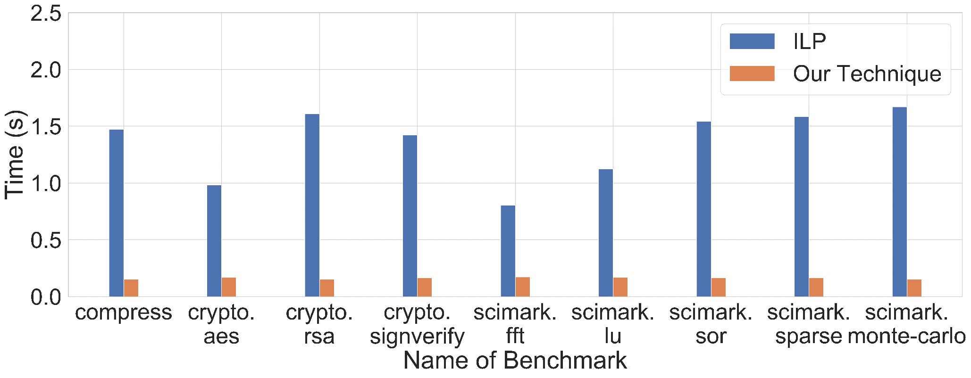
Scheduling Time
Name of Benchmark
Our algorithm runs much faster than ILP
Notes:
T4 -> 30
T5 starts at max(30 + 20, 42) = 50
T5 ends at 52
T6 starts at 72
T6 ends at 82

Slide 57
Satisfying Latency Constraint over a Lossy Channel
Smartphone
Cloud Server
Model the number of retransmissions as a Binomial process
Approximate the number of retransmission attempts needed using Hoeffding’s inequality
We propose a heuristic that satisfies the given constraint while reducing expected finish time
Notes:
No need to discuss the current approach. Also change this spectrum or signal map.

Slide 58
Content Outline
Introduction and Motivation
Low-cost Spectrum Monitoring
Computation Offloading to Reduce Execution Time
Summary
Notes:
No need to discuss the current approach. Also change this spectrum or signal map.

Slide 59

Summary
Offline Sensor
Selection
Online Sensor
Selection
Algorithm to minimize execution time
Low-cost Spectrum Monitoring
Computation
Offloading
Low-cost Spectrum Monitoring
FPGA-based
Sensors
Fusion of Noisy Sensors
Heuristic to satisfy latency constraint
Notes:
No need to discuss the current approach. Also change this spectrum or signal map.

Slide 60
Publications Part of this Thesis:
Spectrum Monitoring
Arani Bhattacharya, Caitao Zhan, Himanshu Gupta, Samir R Das, Petar M. Djuric; Selection of Sensors for Efficient Transmitter Localization, Under Submission at IEEE Infocom 2020
Arani Bhattacharya, Ayon Chakraborty, Samir R Das, Himanshu Gupta, Petar M. Djuric; Spectrum Patrolling with Crowdsourced Spectrum Sensors, Accepted for Publication at IEEE Transactions on Cognitive Communications and Networking
Arani Bhattacharya, Han Chen, Peter Milder, Samir R. Das, Quantifying Energy and Latency Improvements of FPGA-Based Sensors for Low-Cost Spectrum Monitoring, IEEE DySPAN 2018
Ayon Chakraborty, Arani Bhattacharya, Snigdha Kamal, Samir R Das, Himanshu Gupta, Petar M. Djuric; Spectrum Patrolling with Crowdsourced Spectrum Sensors, IEEE INFOCOM 2018
Notes:
No need to discuss the current approach. Also change this spectrum or signal map.

Slide 61
Publications Part of Thesis:
Computation Offloading
Arani Bhattacharya, Ansuman Banerjee, Pradipta De; Scheduling with Task Duplication for Application Offloading, IEEE CCNC 2017
Arani Bhattacharya, Ansuman Banerjee, Pradipta De; Service Level Guarantee for Mobile Application Offloading in Presence of Wireless Channel Errors, IEEE Globecom 2016
Arani Bhattacharya, Pradipta De; Computation offloading from mobile devices: Can edge devices perform better than the cloud?, Third International Workshop on Adaptive Resource Management and Scheduling for Cloud Computing. ACM, 2016
Arani Bhattacharya, Ansuman Banerjee, Pradipta De; Parametric Analysis of Mobile Cloud Computing Frameworks using Simulation Modeling, Second International Workshop on Adaptive Resource Management and Scheduling for Cloud Computing. ACM, 2016
Notes:
No need to discuss the current approach. Also change this spectrum or signal map.

Slide 62
Other Related Publications
Vasudevan Nagendra, Arani Bhattacharya, Anshul Gandhi, Samir R. Das; Scalable and Resource Efficient Control Plane for Next Generation Cellular Packet Core, ACM Symposium on SDN Research (SOSR) 2019
Sohee Park, Arani Bhattacharya, Zhibo Yang, Mallesham Dasari, Samir R. Das, Dimitris Samaras; Advancing User Quality of Experience in 360-degree Video Streaming, IFIP Networking Conference 2019
Mallesham Dasari, Muhammad Bershgal Atique, Arani Bhattacharya, Samir R. Das; Spectrum Protection from Micro-Transmissions Using Distributed Spectrum Patrolling, Passive and Active Measurement (PAM) 2019
Mallesham Dasari, Santiago Vargas, Arani Bhattacharya, Aruna Balasubramanian, Samir R Das, Michael Ferdman; Impact of device performance on mobile internet QoE, ACM Internet Measurement Conference (IMC) 2018
Sohee Kim Park, Arani Bhattacharya, Mallesham Dasari, Samir R. Das; Understanding User Perceived Video Quality using Multipath TCP over Wireless Network, IEEE Sarnoff Symposium 2018
Arani Bhattacharya, Pradipta De; A Survey of Adaptive Techniques in Computation Offloading, Journal of Network and Computer Applications, 2017
Ayon Chakraborty, Arani Bhattacharya, Santosh Ghosh, Samir R. Das; A first look at performance of TV streaming sticks, IEEE Sarnoff Symposium 2017
Notes:
No need to discuss the current approach. Also change this spectrum or signal map.

Slide 63
Summary
Offline Sensor
Selection
Online Sensor
Selection
Algorithm to minimize execution time
Low-cost Spectrum Monitoring
Computation
Offloading
Low-cost Spectrum Monitoring
FPGA-based
Sensors
Fusion of Noisy Sensors
Heuristic to satisfy latency constraint
Notes:
No need to discuss the current approach. Also change this spectrum or signal map.

