Slide 1


Selection of Sensors for Efficient Transmitter Localization
Arani Bhattacharya, Caitao Zhan, Himanshu Gupta, Samir R. Das, Petar M. Djuric
Notes:
Good afternoon everyone. I am Arani Bhattacharya of Stony Brook University, and I would like to present out work “A First Look at Performance of TV Streaming Sticks”.

Slide 2
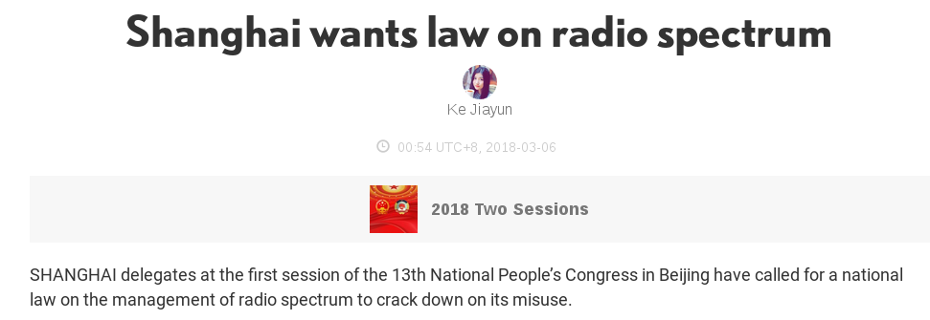
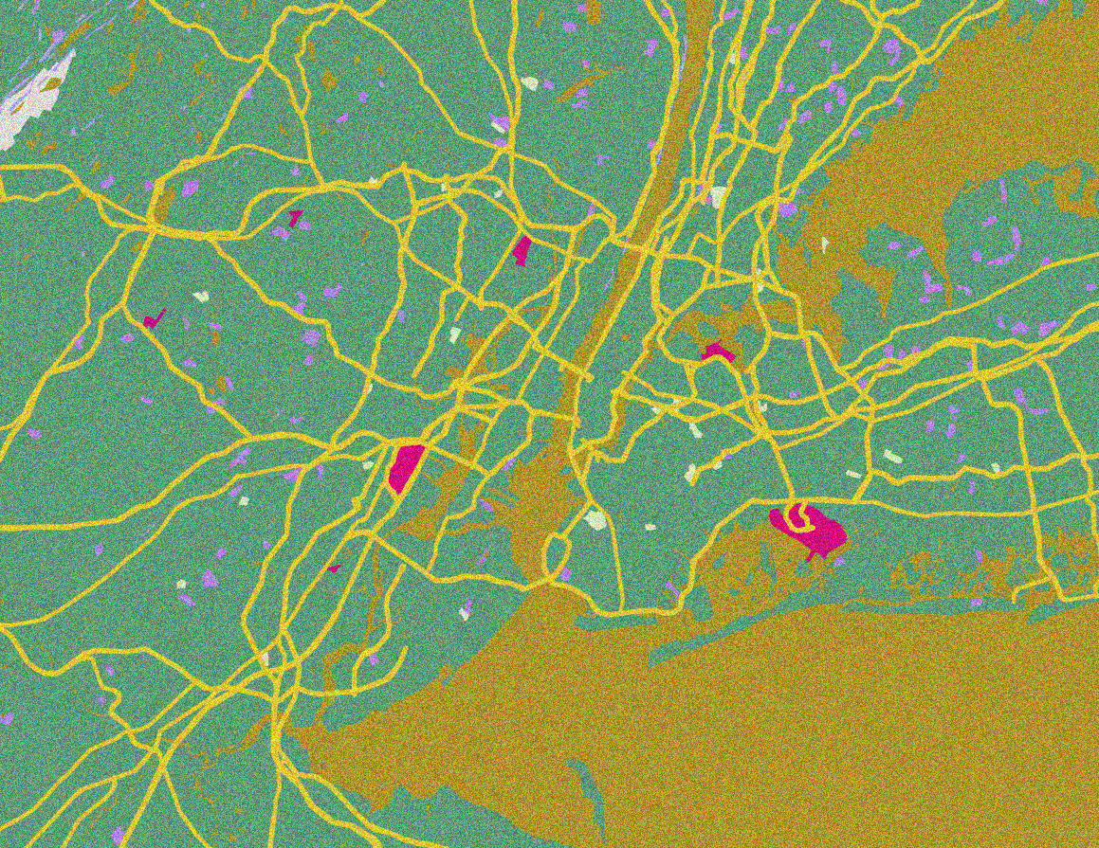




Rising Threat of Unauthorized Transmission
Intruder
(Unauthorized transmitter)
?
How can we monitor spectrum?
Notes:
With the arrival of smart TVs, streaming sticks are used to stream movies and other videos over the Internet. These sticks have the form factor of a dongle and they are plugged into the HDMI port of TVs. There are three TV streaming sticks that are commonly available in the US market – Amazon Fire, Chromecast and Roku. A key question of active interest for users is the difference among these devices.

Slide 3


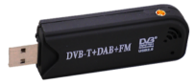
A Distributed Spectrum
Monitoring System
Spectrum
sensors
?
Fusion Center
Location of Unauthorized Transmission
Deploy large number of cheap but noisy spectrum sensors;
utilize robust localization to reduce impact of noise
Notes:
With the arrival of smart TVs, streaming sticks are used to stream movies and other videos over the Internet. These sticks have the form factor of a dongle and they are plugged into the HDMI port of TVs. There are three TV streaming sticks that are commonly available in the US market – Amazon Fire, Chromecast and Roku. A key question of active interest for users is the difference among these devices.

Slide 4

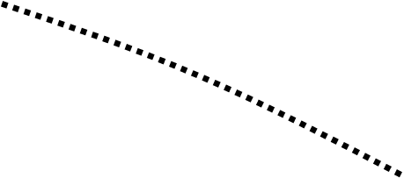
Running Sensors has a Recurring Cost
May have limited energy
Cost of data transmission
Fusion Center
Location of Unauthorized Transmission
Notes:
With the arrival of smart TVs, streaming sticks are used to stream movies and other videos over the Internet. These sticks have the form factor of a dongle and they are plugged into the HDMI port of TVs. There are three TV streaming sticks that are commonly available in the US market – Amazon Fire, Chromecast and Roku. A key question of active interest for users is the difference among these devices.

Slide 5

We Focus on Sensor Selection
Select sensors
$$$
Budget
Fusion Center
Location of Unauthorized Transmission
Relevant sensors
Select the most relevant sensors to localize
unauthorized transmission
Notes:
With the arrival of smart TVs, streaming sticks are used to stream movies and other videos over the Internet. These sticks have the form factor of a dongle and they are plugged into the HDMI port of TVs. There are three TV streaming sticks that are commonly available in the US market – Amazon Fire, Chromecast and Roku. A key question of active interest for users is the difference among these devices.

Slide 6
Content
Motivation of Sensor Selection
Problem Formulation
Our Algorithm
Evaluation

Slide 7

Sensor Selection: Optimization Problem
?
Max Accuracy subject to: # Sensors ≤ Budget
Need to define accuracy of localization
Notes:
No need to discuss the current approach. Also change this spectrum or signal map.

Slide 8
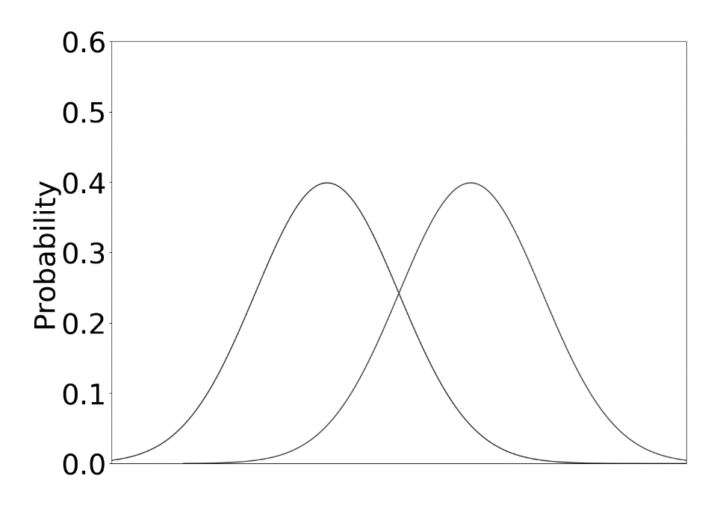




Localization is a form of
Hypothesis Classification
Known a priori by training
Distribution of Location L1
Distribution of Location L2
?
Classify data point using a threshold.
Threshold value given by Maximum a Posteriori Estimate
$$N(μ_{1},σ^{2})$$
$$N(μ_{2},σ^{2})$$
$$N(μ_{1},σ^{2})$$
$$N(μ_{2},σ^{2})$$
Sensing Metric
Select sensors
Well-known for providing the optimal accuracy
Notes:
With the arrival of smart TVs, streaming sticks are used to stream movies and other videos over the Internet. These sticks have the form factor of a dongle and they are plugged into the HDMI port of TVs. There are three TV streaming sticks that are commonly available in the US market – Amazon Fire, Chromecast and Roku. A key question of active interest for users is the difference among these devices.

Slide 9
Maximum a Posteriori Estimate in a Realistic Setting
L₁
L₂
L₃
Divide entire area into grid cells
?
L_{m}
Collect training data corresponding to each grid cell
P(X_{i} | L_{i}) = Data if intruder is at L_{i} = Known by training
Notes:
No need to discuss the current approach. Also change this spectrum or signal map.

Slide 10


Maximum a Posteriori Estimate in a Realistic Setting
P(L₁)
P(L₂)
P(L₃)
Divide entire area into grid cells
?
P(L_{m})
Compute probability of intruder at each location by Bayes rule
$$X=[X_{1}…X_{n}]$$
$$P\left(L_{i} | X\right) α P\left(X | L_{i}\right)P(L_{i})$$
Notes:
No need to discuss the current approach. Also change this spectrum or signal map.

Slide 11

Maximum a Posteriori Estimate in a Realistic Setting
L₁
L₂
L₃
Divide entire area into grid cells
?
P(L_{m})
Compute probability of intruder at each location by Bayes rule
Select maximum
$$MAP=\arg{\max_{i}{P\left(L_{i} | X\right)}}$$
Notes:
No need to discuss the current approach. Also change this spectrum or signal map.

Slide 12
Can we define accuracy of MAP?
L₂
L₃
P(MAP = 1 | L₁)
L_{m}
Notes:
No need to discuss the current approach. Also change this spectrum or signal map.

Slide 13
Can we define accuracy of MAP?
L₁
L₃
P(MAP = 1 | L₁)
P(MAP = 2 | L₂)
L_{m}
Notes:
No need to discuss the current approach. Also change this spectrum or signal map.

Slide 14
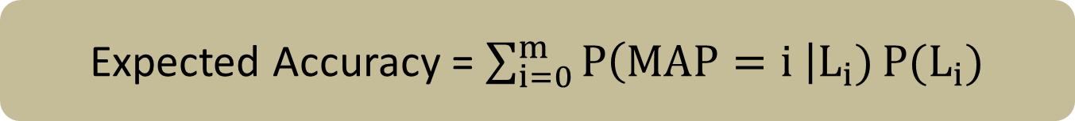
Accuracy of MAP:
Probability of MAP giving right location
L₁
L₂
L₃
P(MAP = 1 | L₁)
P(MAP = 2 | L₂)
.
.
.
P(MAP = m | L_{m})
Expected Accuracy = $\sum_{i=0}^{m}{P\left(MAP=i \right|L_{i})}P(L_{i})$
Notes:
No need to discuss the current approach. Also change this spectrum or signal map.

Slide 15
Sensor Selection: Optimization Problem
L₁
L₂
L₃
L_{m}
Max Accuracy subject to: # Sensors ≤ Budget
Notes:
No need to discuss the current approach. Also change this spectrum or signal map.

Slide 16
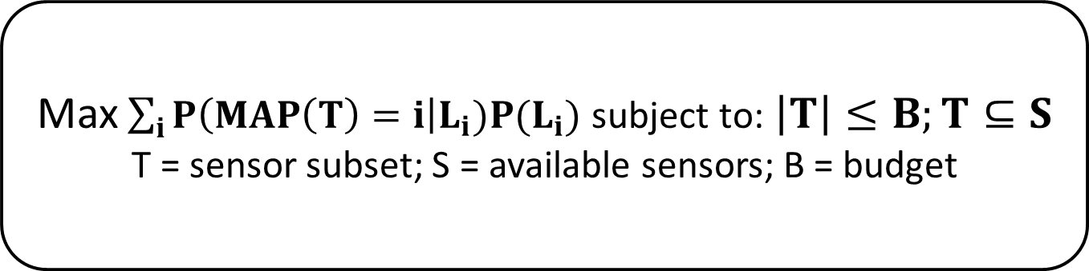
Sensor Selection as an
Optimization Problem
L1
L2
L3
Lm
Max$\sum_{i}{P\left(MAP\left(T\right)=i\right|L_{i})P(L_{i}) }$subject to:$\left|T\right|≤B;T⊆S$
T = sensor subset; S = available sensors; B = budget
NP-Hard Problem; variant of stochastic set cover.
Our goal is to find an approximate solution
Notes:
No need to discuss the current approach. Also change this spectrum or signal map.

Slide 17
Content
Motivation of Sensor Selection
Problem Formulation
Our Algorithm
Evaluation

Slide 18
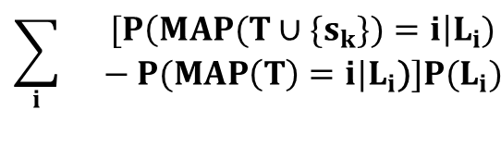
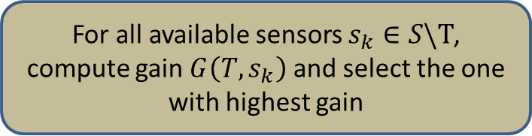
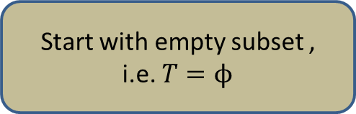
A “Greedy” Algorithm
“Monotone”:
No sensor has a negative gain
Start with empty subset ,
i.e. $T=ϕ$
“Submodular”:
Gains follow law of diminishing returns
$$\sum_{i}{}\begin{aligned}[P\left(MAP(T∪\{s_{k}\})=i\right|L_{i}) \\ − P(MAP\left(T\right)=i|L_{i}\text{)}]P(L_{i})\end{aligned}$$
For all available sensors $s_{k}∈S\backslash T$, compute gain $G\left(T,s_{k}\right)$ and select the one with highest gain
Accuracy of Localization
Accuracy of Detection
No
Budget reached?
Approximation factor of 1 – 1/e,
subject to conditions
Size of subset
Size of subset
Return selected sensors
Notes:
No need to discuss the current approach. Also change this spectrum or signal map.

Slide 19
Two Key Conditions on Objective Function
“Monotone”:
No sensor has a negative gain
“Submodular”:
Gains follow law of diminishing returns
Accuracy of Localization
Accuracy of Localization
Size of subset
Size of subset
Monotone submodular objectives have approximation results using greedy algorithm
Notes:
No need to discuss the current approach. Also change this spectrum or signal map.

Slide 20


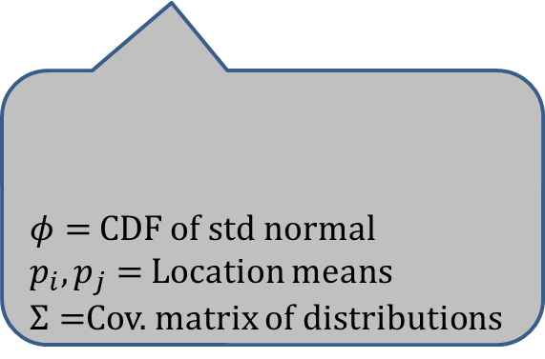
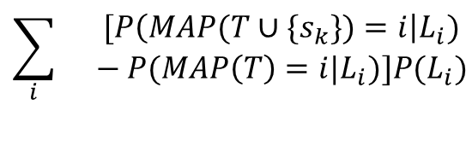
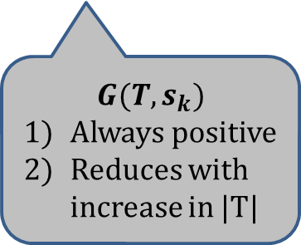
Case of Two Locations
“Monotone”:
No sensor has a negative gain
Start with empty subset ,
i.e. $T=ϕ$
“Submodular”:
Gains follow law of diminishing returns
$$\sum_{i}{}\begin{aligned}[P\left(MAP(T∪\{s_{k}\})=i\right|L_{i}) \\ − P(MAP\left(T\right)=i|L_{i}\text{)}]P(L_{i})\end{aligned}$$
For all available sensors $s_{k}∈S\backslash T$, compute gain $G\left(T,s_{k}\right)$ and select the one with highest gain
$$P(MAP\left(T\right)=i|L_{i}\text{)}$$
$φ=$CDF of std normal
$p_{i}, p_{j}=$ Location means
$Σ=$Cov. matrix of distributions
Accuracy of Localization
=
No
Budget reached?
Size of subset
$$G(T, s_{k})$$
Always positive
Reduces with increase in |T|
Return selected sensors
Notes:
No need to discuss the current approach. Also change this spectrum or signal map.

Slide 21
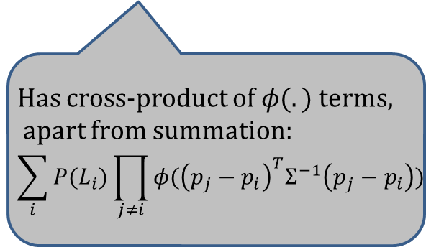
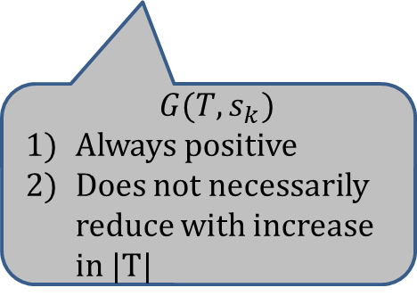
Case of Multiple Locations
“Monotone”:
No sensor has a negative gain
Start with empty subset ,
i.e. $T=ϕ$
$$\sum_{i}{}\begin{aligned}[P\left(MAP(T∪\{s_{k}\})=i\right|L_{i}) \\ − P(MAP\left(T\right)=i|L_{i}\text{)}]P(L_{i})\end{aligned}$$
For all available sensors $s_{k}∈S\backslash T$, compute gain $G\left(T,s_{k}\right)$ and select the one with highest gain
Has cross-product of $φ(.)$ terms,
apart from summation:
$$\sum_{i}{P(L_{i})}\prod_{j≠i}{φ({\left(p_{j}−p_{i}\right)}^{T}Σ^{−1}\left(p_{j}−p_{i}\right))}$$
Accuracy of Localization
No
Budget reached?
Size of subset
$G(T, s_{k})$
Always positive
Does not necessarily reduce with increase in |T|
Return selected sensors
Notes:
No need to discuss the current approach. Also change this spectrum or signal map.

Slide 22


Does Accuracy of Classification Satisfy These Criteria?
“Monotone”:
No sensor has a negative gain
“Submodular”:
Gains follow law of diminishing returns
Accuracy of Localization
Accuracy of Localization
Size of subset
Size of subset
Our objective is NOT submodular;
Greedy algorithm does NOT give approximate result
Notes:
No need to discuss the current approach. Also change this spectrum or signal map.

Slide 23
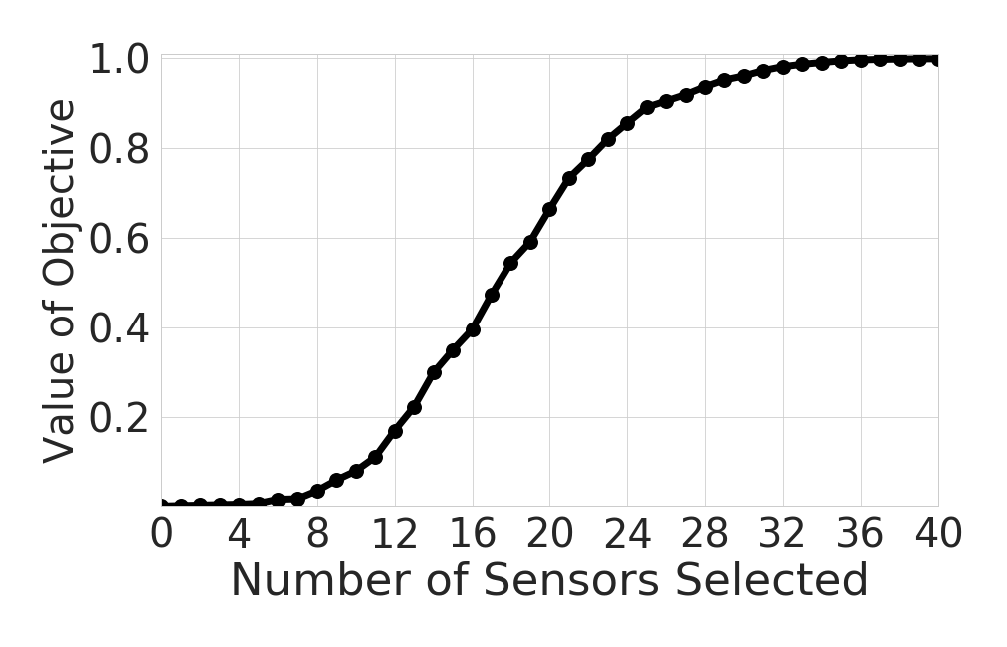
Can be Verified using Experiments
Accuracy of Localization
Not submodular due to presence of cross-product terms
Notes:
No need to discuss the current approach. Also change this spectrum or signal map.

Slide 24
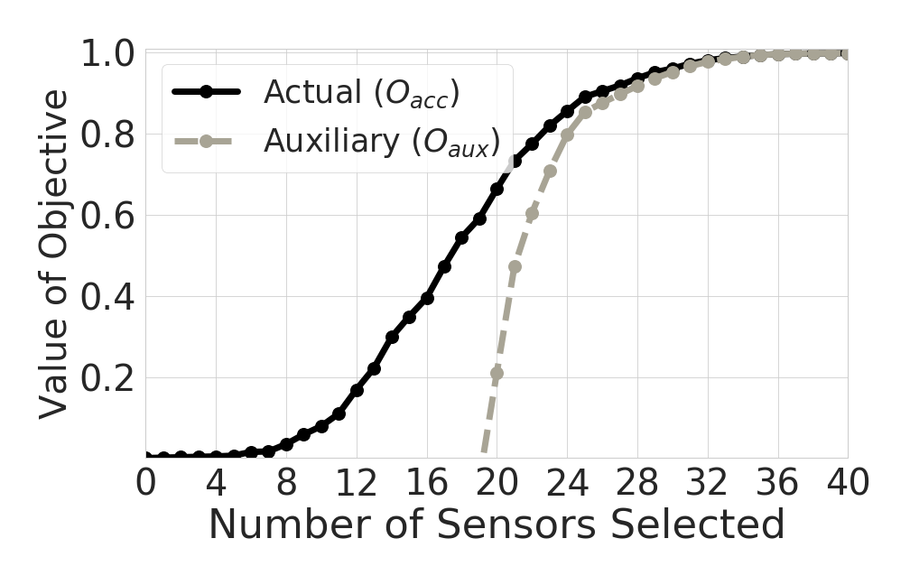
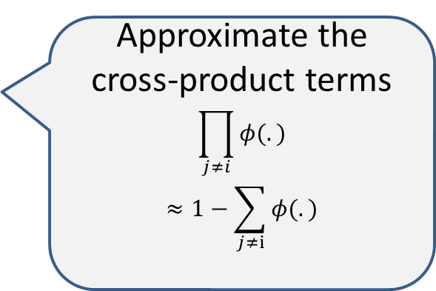
Can we Design an Auxiliary Monotone Submodular Objective?
Approximate the cross-product terms
$$\prod_{j≠i}{φ(.)}$$
$$≈1−\sum_{j≠i}{φ(.)}$$
Accuracy of Localization
(Auxiliary) Greedy algorithm gives near-optimal value of auxiliary objective
Notes:
No need to discuss the current approach. Also change this spectrum or signal map.

Slide 25
Does it Also Give Guarantee on Performance of Actual Objective?
Analytically show that this difference is within a bound.
Bound reduces with an increase in budget
Accuracy of Localization
Applying greedy algorithm on auxiliary objective provides guarantee on accuracy
Notes:
No need to discuss the current approach. Also change this spectrum or signal map.

Slide 26
Content
Motivation of Sensor Selection
Problem Formulation
Our Algorithm
Evaluation

Slide 27

Performance Evaluation
Simulation Based on Propagation Models
Transmitter at 1600 points; 100 sensors
40 m
Landscape based on satellites
40 m
Notes:
No need to discuss the current approach. Also change this spectrum or signal map.

Slide 28
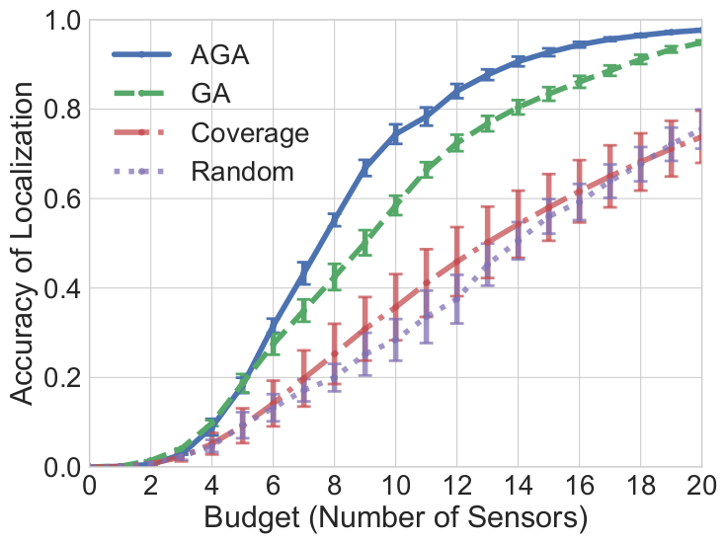
How Does it Compare to State-of-the-art?
Large-scale Simulation
Auxiliary Greedy Algorithm
Greedy Algorithm
Maximizes the coverage area [Mobicom’ 17]
Select sensors randomly
Notes:
No need to discuss the current approach. Also change this spectrum or signal map.

Slide 29
How Does it Compare to State-of-the-art?
Large-scale Simulation
Up to 42% higher accuracy than baseline
Our algorithm provides higher accuracy in practice
Notes:
No need to discuss the current approach. Also change this spectrum or signal map.

Slide 30
Performance Evaluation
Indoor Public Dataset
Transmitters and sensors at 44 locations
Transmits at 2.4 GHz
13 m
14 m
Notes:
No need to discuss the current approach. Also change this spectrum or signal map.

Slide 31
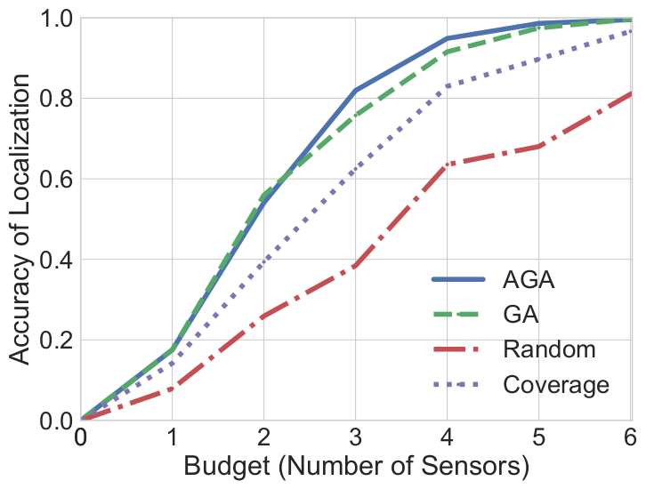
How Does it Compare to State-of-the-art?
Indoor Public Dataset
Up to 18% higher accuracy than baseline
Our algorithm provides higher accuracy in practice
Notes:
No need to discuss the current approach. Also change this spectrum or signal map.

Slide 32
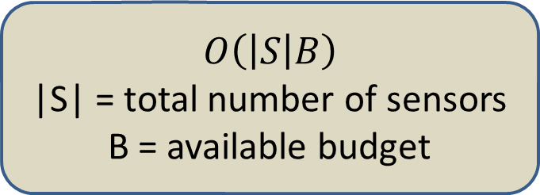
Time Complexity of Our Algorithm
$$O\left(\left|S\right|B\right)$$
|S| = total number of sensors
B = available budget
Does not depend on number of grid cells
Execution time
(Not drawn to scale)
1 min
Intel Core i9 processor with 20 cores; nVidia 1080 GTX GPU
10 s
m = 1600,
|S| = 100,
B = 20
m = 6400,
|S| = 100,
B = 20
Execution Parameters
Auxiliary Greedy algorithm is fast in practice
Notes:
No need to discuss the current approach. Also change this spectrum or signal map.

Slide 33
Takeaways
Sensor selection to localize transmitter
Our sensor selection utilizes submodularity
  Utilizes an auxiliary objective
  Evaluations show large improvement in accuracy
  Runs fast over large instances
Our algorithm works better in practice than existing state of the art
  Additional details and dataset at: cs.sunysb.edu/~arbhattachar/specsense

